Slide 1
String Matching: Plagiarism detection

Slide 2
Plagiarism and its Detection
Plagiarism can be termed as the process of using someone else’s data without giving the necessary credit.
According to Merriam-Webster’s Online dictionary, To plagiarise is to steal the ideas and words of another’s as one’s own or committing literary theft.
Nowadays there are several software that are used to identify if a document is plagiarised or not.
There are several algorithms that can be used to detect if a document is plagiarised or not.

Slide 3
Plagiarism Detection Algorithms
Naïve String Search Algorithm
Knuth-Morris-Pratt Algorithm
Longest Common Subsequence
Boyer-Moore Algorithm

Slide 4
Naïve String Search Algorithm
This algorithm takes both the original list of files and the file that is suspected to be plagiarised.
Input :
List of all the original text documents
The file that is suspected to be plagiarised
The Algorithm works in such a way that, it compares the first letter in the sentence of the plagiarised text, to the first letter in the sentence of the original text.
If a match takes place, the next concurrent character is compared. If a match does not take place, the next character of the plagiarised sentence is compared with the first character of the original text.

Slide 5
Naïve String Search - Pseudocode
naive_str(pat, text):
n <- length(text)
m <- length(pat)
for ( s <- 0 to n – m)
do
if pat[1…m] == text[s+1 …. s+m]
then print “Pattern found at” s
Time Complexity : O(n)

Slide 6
Knuth-Morris-Pratt Algorithm
This algorithm work in a similar fashion to that of the Naïve string search.
It takes both the original text files and the suspected plagiarised file as input.
A prefix array is used at the beginning of the phase.
The index of the prefix array is used to move the comparing pattern by a few places.
This algorithm saves us a lot of time.

Slide 7
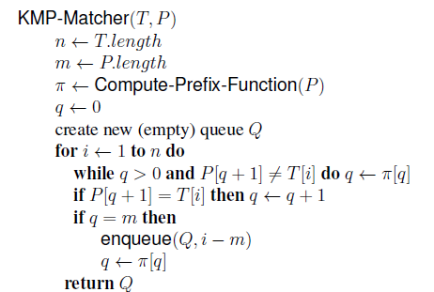
Knuth-Morris-Pratt Pseudocode

Slide 8
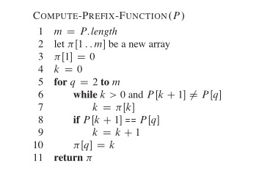
Knuth-Morris-Pratt Algorithm
Time Complexity : O(m+n)

Slide 9
Longest Common Subsequence Algorithm
This is a powerful algorithm that detects the longest common subsequence that occurs in both the plagiarised text and the original text.
The LCS algorithm takes two strings in general and finds the longest subsequence common to both of the string.
A matrix is built which helps us find the longest common subsequence.

Slide 10
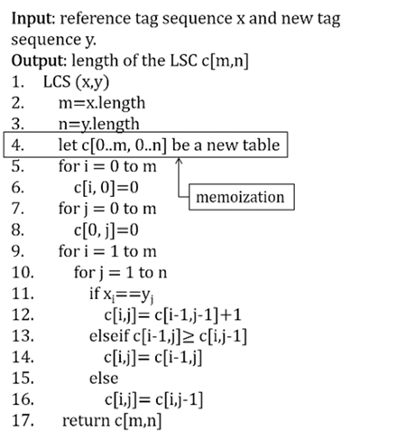
Longest Common Subsequence Pseudocode
Time Complexity : O(mn)

Slide 11
Boyer-Moore Algorithm
This Algorithm creates an index array for the plagiarised text.
It is a standard bench mark for practical string search literature.
This algorithm runs faster as the pattern length increases.
It has 2 shift rules, namely the bad character rule and the good suffix rule

Slide 12
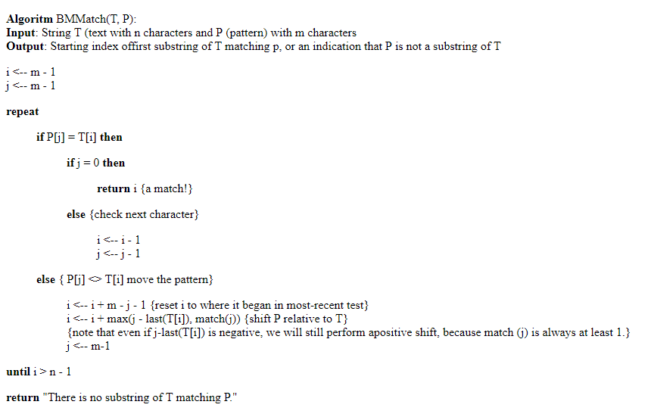
Boyer-Moore Pseudocode
Time Complexity : O(m+n)

Slide 13
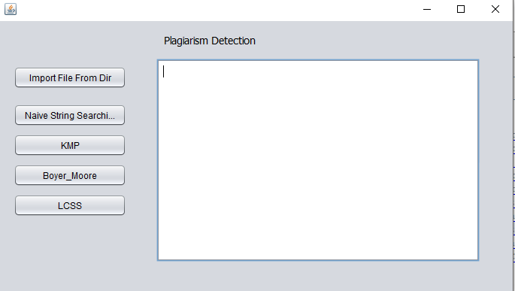
The User Interface

Slide 14
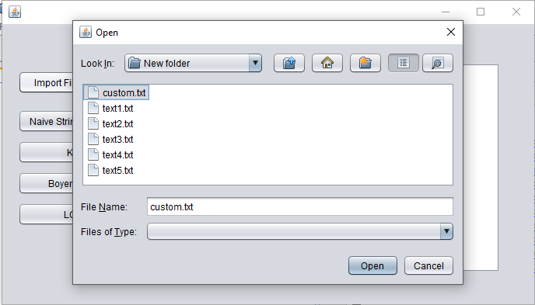
Selecting the Plagiarised File

Slide 15
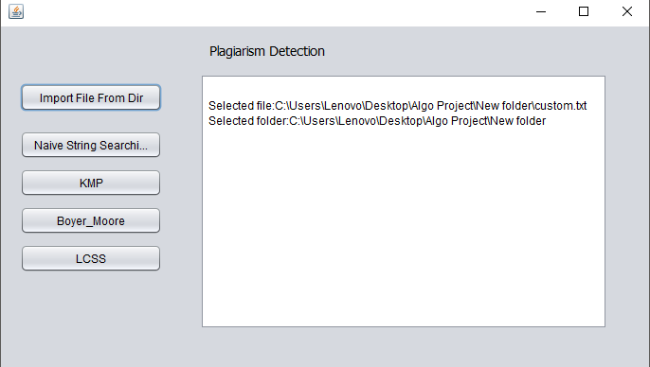
File has been Loaded

Slide 16
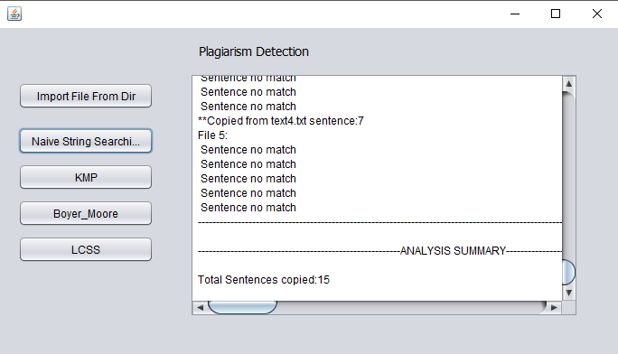
Output for Naïve String Matching

Slide 17
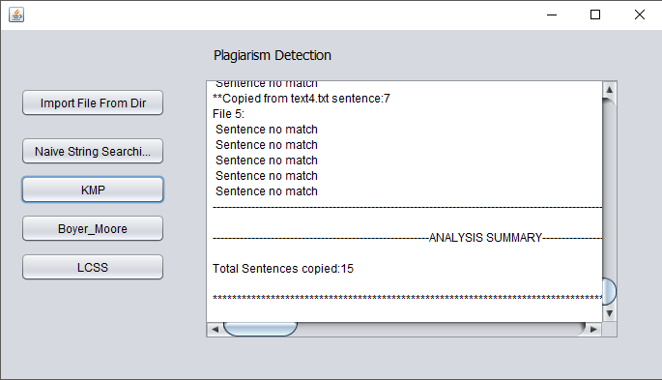
Output for KMP

Slide 18
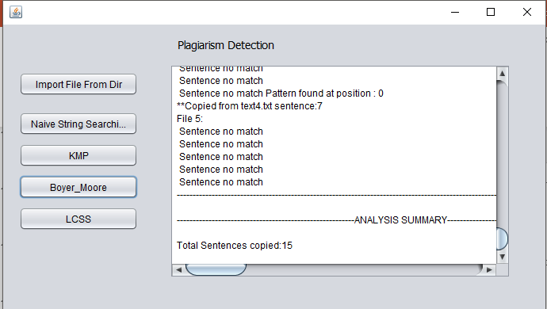
Output for Boyer_Moore

Slide 19
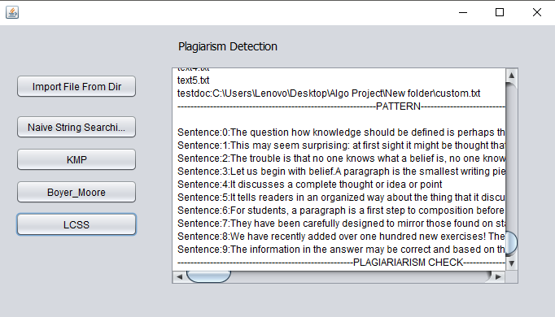
Output For LCSS : Every paragraph is taken as a sentence

Slide 20
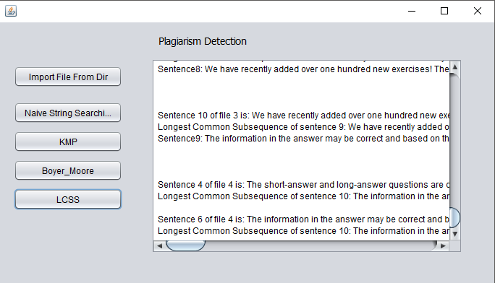
Output for LCSS

Slide 21
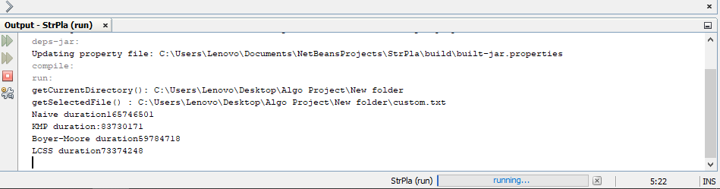
Duration of the Algorithms shown in the Output Window

